Slide 1
Unit 5: Week 1
Grade K

Slide 2
Copyright © Savvas Learning Company LLC. All Rights Reserved.
This publication is protected by copyright, and permission should be obtained from the publisher prior to any prohibited reproduction, storage in a retrieval system, or transmission in any form or by any means, electronic, mechanical, photocopying, recording, or otherwise. For information regarding permissions, request forms, and the appropriate contacts within the Savvas Learning Company Rights Management group, please send your query to:
Savvas Learning Company LLC, 15 East Midland Avenue, Paramus, NJ 07652
or
k12learningpermissions@savvas.com
myView Literacy® is an exclusive trademark of Savvas Learning Company LLC in the U.S. and/or other countries.

Slide 3
Page 8
Introduce the Unit
Essential Question: What can we learn from the weather?
What did you hear about weather in the video?
What see about weather in the video?
Notes:
Introduce the Essential Question for Unit 5: What can we learn from the weather? Explain to students that they will read texts in the informational, poetry, and drama genres to learn about different weather that we experience. Tell them that reading texts in different genres allows them to experience different authors’ points of view about the theme.
Watch the Unit Video – Remind students that videos are multimedia texts. This is because videos have sound and pictures. Play the Unit 5 Video. Direct students to pay attention to what they hear and see about different kinds of weather. Click Path: Table of Contents -> Unit 5: Outside My Door-> Unit 5: Introduction
Have partners discuss the kinds of weather they learned about from the video. If students did not understand something in the video, have them ask a question and figure out the answer with their partner. Use the following questions to guide their discussions:
What did you hear about weather in the video?
What did you see about weather in the video?

Slide 4
Page 12
Unit Goals
Turn to page 12 in your
Student Interactive.
Color the shape next to
each goal as it is read.
Notes:
Read to students the goals on p. 12 of the Student Interactive.
Tell them to color the shape next to each goal while it is read.
Discuss with the class what weather is and what weather is not. Use the photographs on p. 12 as references.
Have students circle the pictures of weather that are inside the box on p. 12 in the Student Interactive.

Slide 5
Page 13
Academic Vocabulary
Turn to page 13 in your Student Interactive.
Notes:
Remind students that Academic Vocabulary is language used when talking about ideas. Tell students that they will learn and use these words to talk about weather as they work through the unit. Have students turn to p. 13 in the Student Interactive. Read aloud the words and discuss the meanings of the words.
Have students look at the pictures. Guide students in a discussion about what the pictures show and how they think the pictures relate to the Academic Vocabulary words.
Tell students to match the words on p. 13 to the pictures that show the meanings of the words.

Slide 6
Lesson 1

Slide 7
Phonological Awareness
flashlight
catfish
football
sunshine
Notes:
Tell students that syllables are the chunks we can hear in words and today they will break apart and put together syllables. Say: Watch how I break apart and put together a word. Display a picture of a flashlight that is cut into two pieces. Hold the pieces close together. Say: My word is flashlight. As you say the word, run a finger under the two parts to show that they are connected. Say: Watch now as I break the word apart, or segment the syllables. Pull the pieces of the picture apart as you say: flash (pause) light. Now, I will blend the word back together again. Hold the pieces back together and say: flashlight. Have students segment and blend the word as you separate and hold together the picture pieces.
Continue with other words such as catfish, football, and sunshine. Provide pairs of students with a picture of the word that has been cut into two equal parts. Have pairs put the pieces together and say the word, pull the pieces apart and segment the word, and then put the pieces back together and blend the word.

Slide 8
Page 16
Phonics
cot
cone
cute
can
tube
tag
take
tap
Notes:
Display Picture Card cap. What letter spells the sound /k/ at the beginning of cap? Turn the card over to confirm that the letter c spells the sound /k/ in cap. Have students tell you the letters that are in the word cap. Now let’s practice reading other words with the sound /k/ spelled c.
Write the words cot, cone, cute, and can on the board. Circle the c in each word. Have students read the list. Continue the activity with the letter Tt. Use the tub Picture Card and write the words tube, tag, take, and tap on the board. Click path -> Table of Contents -> Unit 5 Week 1 Informational Text -> Lesson 1
Continue the routine with these words: case, cut, tape, ten.

Slide 9
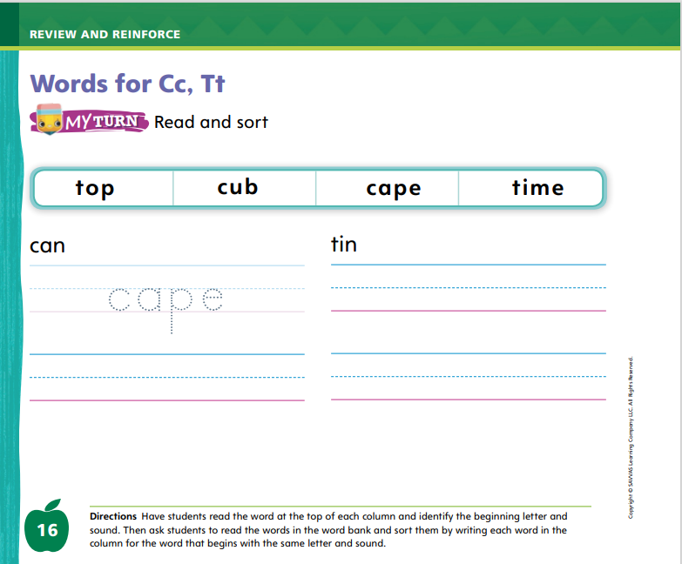
Page 16
Phonics
Turn to page 16 in your Student Interactive.
Notes:
Have students look at p. 16 in the Student Interactive. Have students read the words in the bank.
Then have them read the words at the top of each column. What are the beginning letters? Students should say c and t.
Have students write each word from the word bank in the column with the word that begins with the same letter.
Then have them read the words again.

Slide 10
High-Frequency Words
be
saw
our
Notes:
Display the high-frequency words be, saw, and our, and read them aloud.
Point to each word and have students read it.
Point to each word and have students spell it.
Then have them read each word again.

Slide 11
Page 14, 15
Interact with Sources
Talk about what you can learn from the different parts of the Web site.
Notes:
Remind students of the Unit 5 Essential Question: What can we learn from the weather? Then introduce them to the Weekly Question: How have people learned to live in bad weather? Tell students that over the week they will read about different ways that people have learned to live in bad weather.
Have students turn to p. 14 of the Student Interactive. Read aloud the heading. Engage students in the topic by asking them what today’s weather is like. Ask: Do you think the weather is the same everywhere in the country? Guide students to recognize that the weather can be different in different places.
Direct students’ attention to p. 14 and guide them in recognizing the characteristics of a Web site.
Point out that this is a page from a Web site, which is a digital text.
Tell students that Web sites can be viewed on a computer, tablet, or phone.
Say: Raise your hand if you have ever seen a Web site. What do you see on the Web site on these pages?
Have students look at the Web site as you read aloud the text and labels. Ask students to point to the address bar at the top and the search bar. Then have students tell about other parts of the Web site they see on these pages.
Have students discuss with a partner the characteristics of the Web site and what they can learn from the various parts of the digital text.
Read aloud the Week 1 Question: How have people learned to live in bad weather? Ask students to share some ideas about what they do when the weather is bad, such as stay inside, carry an umbrella, or dress appropriately. Explain that they will be learning more this week about how people have learned to deal with bad weather.

Slide 12
Listening Comprehension
The Shaking Earth
Main Idea: An Earthquake is the shaking of the Earth.
The Earth moves all the time.
Notes:
Tell students that they will listen to a story. Have students listen as you read aloud “The Shaking Earth.” Prompt students to be active listeners by looking at you and thinking about the meaning of the story. Encourage them to seek clarification if something is not understood as you read.
Read the entire text aloud without stopping for the Think Aloud callouts.
Reread the text aloud, pausing to model Think Aloud strategies related to the genre.
Use the chart to help students identify details that support the main idea.

Slide 13
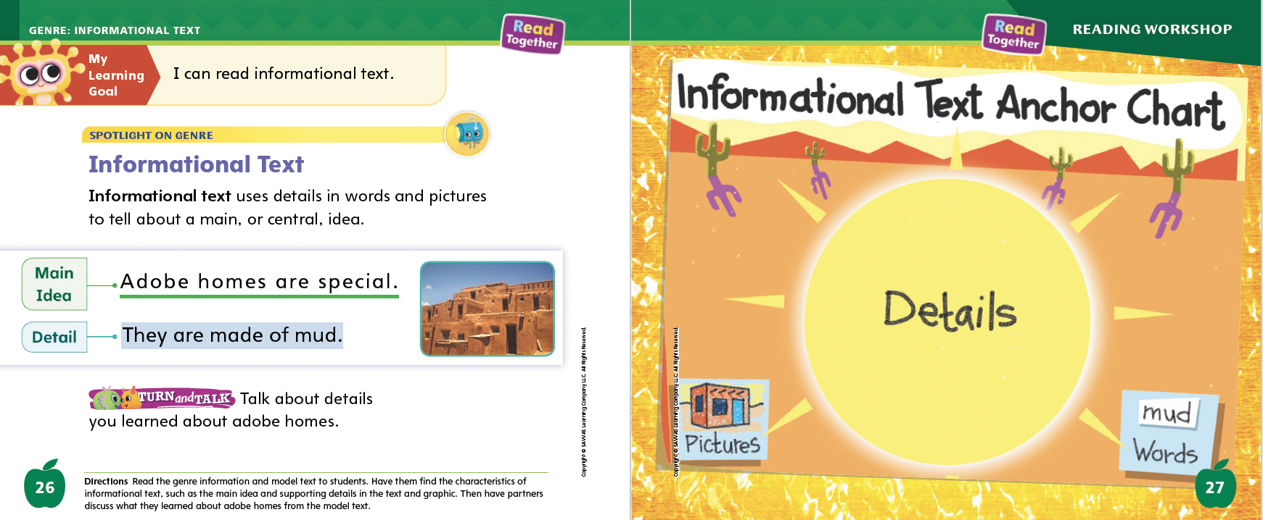
Page 26, 27
Informational Text
Turn to page
26 in your Student Interactive.
Notes:
Tell students that an informational text has a main, or central, idea. There are facts and details that support, or tell more about, the main idea. Share these strategies for determining main idea and details:
Read the title. Does it tell you what the text is about?
Look at the pictures. What do they show?
Read the text. What does the author want you to know?
Read aloud the text on p. 26 of the Student Interactive. Help students recognize the connection between the detail and the main idea: The fact that adobe homes are made of mud is a detail. It tells one reason that adobe homes are special. Other details in the text will tell other reasons. Details support the main idea in an informational text.
Editable Anchor Chart Click Path: Table of Contents -> Reading Anchor Charts -> Unit 5 Week 1: Informational Text Editable Reading Anchor Chart

Slide 14
Page 26
Apply
Talk about details you learned about adobe homes.
Notes:
Have students use the strategies to identify characteristics of informational text.
Have students turn and talk with a partner about what they learned about adobe homes. Then have volunteers share their ideas with the class.

Slide 15
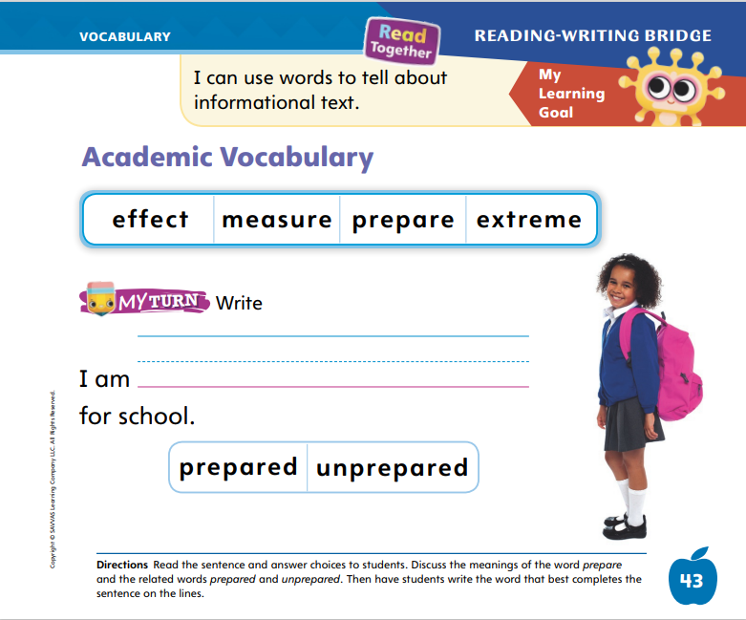
Page 43
Academic Vocabulary
happy
Turn to page 43 in your Student Interactive.
unhappy
Notes:
Tell students that word parts can be added to words to make new words.
Word parts can be added to the beginning of words. For example, un- can be added to some words to mean “not.”
Word parts can be added to the end of words. For example, -ed can be added to some verbs to mean something that already happened.
Look at a word. Can you find a word within the word?
Write the word happy on the board. I can add the word part un- to the beginning of this word to make a new word. Unhappy means “not happy.” Knowing related words can help readers figure out the meaning of new words.
Read the words on p. 43 of the Student Interactive with students and discuss their meanings. Point out the words prepared and unprepared. Ask what word parts have been added to the word prepare.
Read aloud the sentence on p. 43 and guide students to complete the sentence with the correct word.

Slide 16
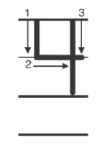
Handwriting
Notes:
Tell students that today they are going to practice writing the numerals 3 and 4. Point to the first numeral on the classroom number line and count chorally until you reach the number 3 and then 4.
Model writing the numeral 3. Have students practice writing the numeral 3 in the air with their finger. Repeat with the numeral 4.
Have students use Handwriting p. 268 in the Resource Download Center to practice writing 3 and 4. Click path: Realize -> Table of Contents -> Resource Download Center -> Handwriting Practice -> U5W1L1 Handwriting Practice

Slide 17
Page 47
Writing – Literary Nonfiction
Turn to page 47 in your Student Interactive.
Notes:
Question and answer books are a form of literary nonfiction. They are based on real-life topics, usually science, math, history, or social studies. Question and answer books:
answer more than one question about the same topic.
include questions that start with who, what, where, when, why, or how.
provide answers to help the reader better understand the topic.
Inform students that they will be exploring question and answer books over the next few days to prepare them to write their own. Choose a stack book. Read aloud the book to students, showing them where the questions and answers are on each page. Point out how the questions and answers are differentiated (bold, color, placement, etc.). When reading a question and answer book, emphasize the question words.
Use the following questions to prompt a discussion.
What topic does this book tell about?
Why did the author use questions and answers to tell about this topic?
How do the pictures tell about the questions and answers?
Direct students to p. 47 in the Student Interactive. Use this page to talk about the elements in a question and answer book. As time allows, read additional stack books.

Slide 18
Independent Writing
Let’s look at question and answer book structure.
Share what you noticed about question and answer books.
Notes:
If students need more time to develop their understanding of the question and answer format, they should read additional stack books.
Writing Support
Modeled - Show a stack text and think aloud to identify elements of a question and answer book.
Shared - Have students choose a stack text to identify the elements of a question and answer book.
Guided - Use a stack text to provide explicit instruction on why authors write question and answer books.
If students demonstrate understanding, they may transition to writing a book of their own.
Call on a few students to share what they noticed about question and answer books.

Slide 19
Spelling
Tap your forehead.
The man wore a hat.
I saw a good movie.
Jay pets the cat.
Do not kick the ball.
What do you want to be when you grow up?
Notes:
(Note: Move the orange boxes to cover each bold spelling word before you read aloud the words and sentences.)
Read aloud the words and sentences. Have students spell each word with initial consonant blends and the two high-frequency words.
Tap your forehead.
The man wore a hat.
I saw a good movie.
Jay pets the cat.
Do not kick the ball.
What do you want to be when you grow up?
Reveal the spelling word and have students check their work.

Slide 20
Language and Conventions
who
what
when
where
why
how
Practice asking questions that begin with one of the question words.
Notes:
Remind students of the question words who, what, when, where, why, and how.
Tell students that questions often begin with one of these question words. Work with the class to create a question for each of the question words.
Write the six question words on index cards. Have students take turns pulling a card and asking you a question beginning with the question word.

Slide 21
Lesson 2

Slide 22
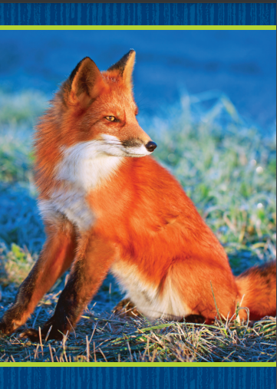
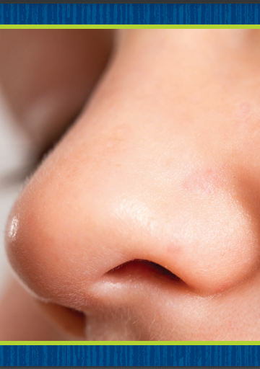
Phonics
o
o_e
Notes:
Hold up the fox Picture Card. This is a picture of a fox. Listen to the sounds in the word: /f/ /o/ /ks/. I hear the sound /o/ in the middle of fox. Say the sound /o/ with me. Turn the card over. Remind students that the sound /o/ is spelled o.
Hold up the nose Picture Card. This is a picture of a nose. Listen to the sounds in the word: /n/ /ō/ /z/. I hear the sound /ō/ in the middle of nose. Say the sound /ō/ with me. Turn the card over. Remind students that the sound /ō/ is spelled o_e.
Display the letter o and the vowel pattern o_e. Point to the letter o and the pattern o_e. Listen carefully to the following words: tone, top. What sound is in the middle of each word? Listen again: tone, top. Have a volunteer identify the sound in the middle of each word. Click path -> Table of Contents -> Unit 5 Week 1 Informational Text -> Lesson 2

Slide 23
Page 17
Apply
Turn to page 17 in your Student Interactive and complete the activity.
Notes:
Have students turn to p. 17 in the Student Interactive. Listen carefully as I say the sounds: /o/ /o/ /o/; /ō/ /ō/ /ō/. Now let’s look at the first picture and read the sentence. What word finishes the sentence? Let’s circle the word. Guide students as they circle robe. Have students tell you the vowel sound in robe and how it is spelled. (/ō/; o_e)
Have students complete p. 17 in the Student Interactive.

Slide 24
High-Frequency Words
be
saw
our
Notes:
Tell students that high frequency words are words that they will hear and see over and over in texts.
Write and read the words be, saw, and our.
Have students repeat the words after you.
Have students spell each word, clapping as they say each letter.

Slide 25
Page 28
Preview Vocabulary
weather
rainy
windy
snow
Notes:
Tell students that before you read, you will look at some of the words they will see in the text. Introduce the words weather, rainy, windy, and snow on p. 28 of the Student Interactive.
Have students share what they already know about the words. Have students use the vocabulary to tell about today’s weather.
Suggest that students look for these words as you read.

Slide 26
Page 29
First Read Strategies
Notes:
Discuss the First Read Strategies. Have students establish a purpose for reading by telling you why they want to read this text. For example, they can read to learn about what the weather is like in other places.
First Read Strategies
READ Read or listen to the text. Try to focus on what the text is about.
LOOK Look at the pictures to help understand the text.
ASK Ask questions about difficult or unknown words and phrases.
TALK Guide students to talk to a partner about the text.
Students may read independently, in pairs, or as a class. Use the First Read notes to help them connect with the text and guide their understanding.

Slide 27
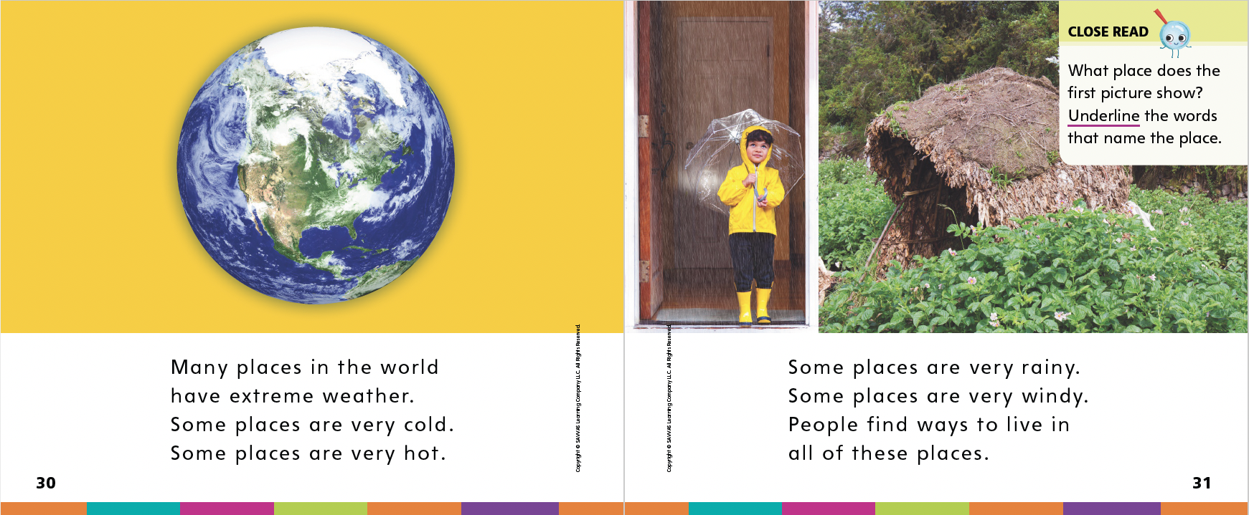
Page 30, 31
First Read – Weather Around the World
Notes:
Read Together.
THINK ALOUD I read the phrase extreme weather, but I don’t know what it means. What can I do? I am going to look closely at the text to see if I can figure it out. The text says some places are very cold and some places are very hot. The next page talks about very rainy and windy places. From this, I can tell that extreme weather is weather that is very difficult to live in.

Slide 28
Page 32, 33
First Read – Weather Around the World
Notes:
Read Together.
THINK ALOUD I read the phrase extreme weather, but I don’t know what it means. What can I do? I am going to look closely at the text to see if I can figure it out. The text says some places are very cold and some places are very hot. The next page talks about very rainy and windy places. From this, I can tell that extreme weather is weather that is very difficult to live in.

Slide 29
Page 34, 35
First Read – Weather Around the World
Notes:
Read Together.
THINK ALOUD The text on p. 35 is about Antarctica. It says Antarctica is very windy. I can look at the picture to learn more about Antarctica. From the snow in the picture, I can tell that Antarctica is very cold.

Slide 30
Page 36, 37
First Read – Weather Around the World
Notes:
Read Together.

Slide 31
Respond and Analyze
Talk: Talk with a partner about what you learned from the text. What was the text mostly about?
Illustrate: Draw one of the places you read about.
Notes:
Use these suggestions to prompt students’ initial responses to Weather Around the World.
Talk Talk with a partner about what you learned from the text. What was the text mostly about?
Illustrate Draw one of the places you read about. Share your drawing with a partner.

Slide 32
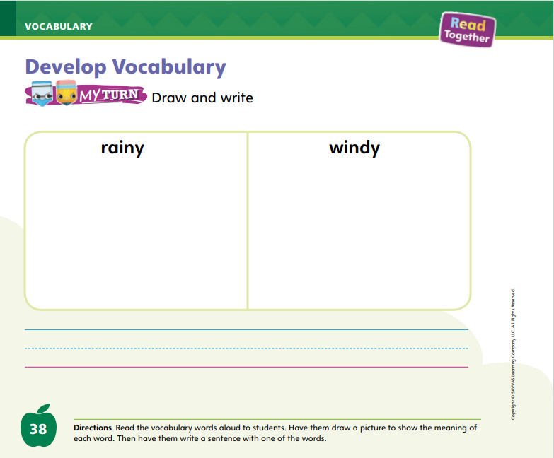
Page 38
Develop Vocabulary
Turn to page 38 in your Student Interactive and complete the activity.
Notes:
Tell students: The author of Weather Around the World chose certain words to tell about the weather.
Read the word.
Think about the meaning of the word. Use the pictures to help you visualize what the word means.
Ask yourself questions, such as: Why did the author choose this word? What does it tell about the main idea?
Have students turn to p. 38 in the Student Interactive. Model a Think Aloud for how you might draw snow. Snow is white. Snow happens when it is very cold. When a lot of snow falls, it covers the grass. It usually snows in the winter when trees have no leaves. I would draw a picture to show the word snow with all white on the ground, trees without leaves, and maybe some snowflakes in the air.
Read aloud the two words in the chart and ask students to draw pictures showing their meaning.
Have students practice developing vocabulary by completing p. 38 in the Student Interactive.

Slide 33
Page 39
Check for Understanding
Turn to page 39 in your Student Interactive and complete the activity.
Notes:
Have students complete the Check for Understanding on p. 39 of the Student Interactive.

Slide 34
Writing – Literary Nonfiction
Let’s choose a topic together as a class.
Now we will come up with questions to include in a question and answer book about our topic.
Notes:
Authors choose the questions for their question and answer books by thinking about what the reader would like to know. Authors may think of the questions first or research the topic and then think about good questions that would help give the reader information about the topic.
Hold up a stack text. Say: This is a question and answer book. Question and answer books have two parts: questions and answers. Today we are going to talk about questions.
Open to the first page that has a question on it. Point to the question. This is a question. How do I know it is a question? I know it is a question because it ends with a question mark. Point to the question mark. Have volunteers draw question marks on the board. This is a question mark. All questions end with a question mark. All questions also begin with certain words. Do you know what words a question might begin with?
Guide students to name the question words who, what, where, why, when, and how. As they name the words, write them on the board. Then read the stack book aloud. As you read each question, ask students what question word the author used and what punctuation mark the question ends with.
Say: As you write your own questions for your question and answer book, you will begin each question with a question word and end each question with a question mark. Let’s practice writing questions.
Have the class choose a topic. Ask students to come up with questions to include in a question and answer book about the topic. Write their responses on the board.

Slide 35
Independent Writing
Think about and choose a topic for your own book.
You will start writing your own question and answer book.
Notes:
For students who still need help understanding the genre, provide them with more exposure to the stack books.
Writing Support
Modeled - Read a stack text aloud and point out how the questions are worded in the text
Shared - Have students read the questions aloud in a stack text to analyze how they are written
Guided - Prompt students to think of questions readers might have about a topic.
After the minilesson, allow students who show understanding to begin writing their own question and answer books.
Have a few students share one question about a topic. Prompt the class to discuss the question and offer additional questions about the topic.

Slide 36
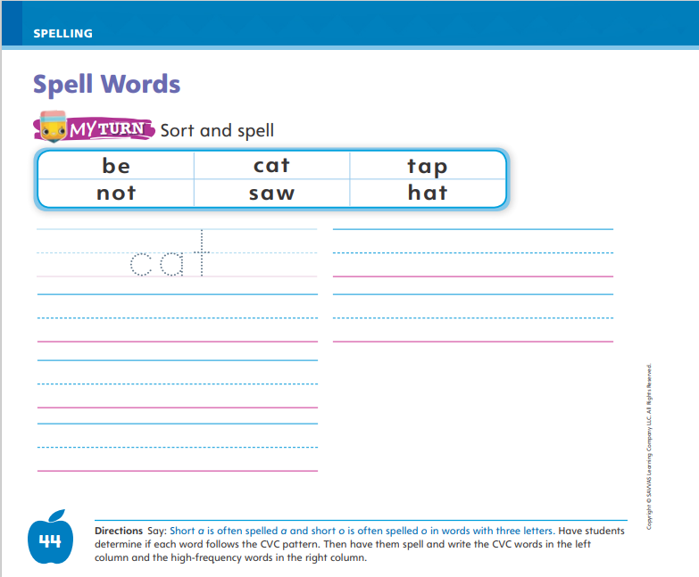
Page 44
Spelling
box
cot
top
Turn to page 44 in your Student Interactive and complete the activity.
Notes:
Explain that words with short vowel sounds are usually spelled with a consonant-vowel-consonant, or CVC, pattern.
Write or display these words: box, cot, top. Say each word aloud and point out that the middle letter in each word is a vowel that spells a short sound. That vowel has a consonant before and after it.
Have students complete the activity on p. 44 in the Student Interactive independently. Provide support as needed.

Slide 37
Language and Conventions
Cats are furry.
I like cats.
What is the first word in the sentence?
What letter does it begin with?
Notes:
Remind students that sentences express complete ideas. A complete sentence has a naming part (a noun) and an action part (a verb). Tell students that sentences begin with a capital letter.
Share an example of a sentence: Cats are furry. Encourage students to listen carefully. What is the first word in this sentence? (Cats) What letter does it begin with? (capital c) Write the word I. Tell students that this is a special word because it is always capitalized. Read aloud a paragraph that has several instances of the word I. Ask students to stand each time they hear a word that should be capitalized.
Say simple sentences. Have volunteers tell you which letters should be capitalized, including the letter at the beginning of each sentence and the word I.

Slide 38
Lesson 3

Slide 39
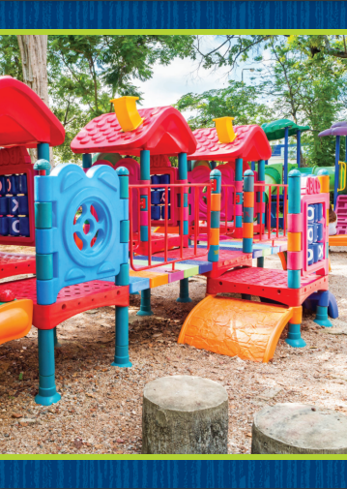
Phonological Awareness
playground
cupcake
backpack
starfish
Notes:
Display the playground Picture Card. This is a picture of a playground. Listen carefully as I count the syllables: play (clap) ground (clap). How many times did I clap? Students should say two. How many syllables are in playground? Students should say two. Say: If I take away the second syllable, ground, what word do I have left? Students should say play. Say: If I take away the first syllable, play, what word do I have left? Students should say ground. Click path -> Table of Contents -> Unit 5 Week 1 Informational Text -> Lesson 3
Have students listen to the syllables in the words cupcake, backpack, and starfish. Have students say each word, segmenting the syllables and identifying which two words make up each word. Then have them practice taking away syllables to make new words.

Slide 40
Page 18
Phonics
tot
Turn to page 18 in your Student Interactive and complete the activity.
tote
cot
Notes:
Write the word tot on the board. This is the word tot. I can read the word: /t/ /o/ /t/, tot. What letter spells the sound /o/ in the middle of tot? What letter spells the sound /t/ at the beginning and end of tot?
Write tote on the board beneath the word tot. This is the word tote. I can read the word: /t/ /ō/ /t/, tote. How do you spell the sound /ō/ in the middle of tote? How do you spell the sound /t/ at the beginning and end of tote?
Write the word cot on the board, and read it with students. Guide students to identify the sounds and spellings for the three sounds in cot.
Listen carefully to the sounds we reviewed today: /o/, /ō/, /k/, /t/. Have volunteers identify the spelling pattern for each of the sounds.
Have students turn to p. 18 in the Student Interactive. Listen carefully as I say the sounds: /o/ /o/ /o/; /ō/ /ō/ /ō/; /k/ /k/ /k/; /t/ /t/ /t/. Now let’s look at the first sentence and read it. Have partners read the rest of the sentences on the page, giving guidance when needed.

Slide 41
Page 19
High-Frequency Words
be
saw
our
Notes:
Tell students that today they are going to continue working with high frequency words. Have students read the words at the top of p. 19 in the Student Interactive with you: be, saw, our.
Have students look at the words at the top of p. 19. Tell them to identify and point to each word when you say it. Say be. Pause to let students find and point to the word. Say our. Say saw. Repeat the activity until students are familiar with each word. Have students use the words in sentences.
Have students read the sentences on p. 19. Ask them to identify the words be, saw, and our in the sentences. Have them underline the high-frequency words in the sentences and then write one of the high-frequency words from this week on the line. Then have them read the sentences with a partner.

Slide 42
Page 29
Connect Text and Illustrations
Notes:
Tell students that readers can make connections between the words in a text and the pictures, or illustrations. The pictures can show more details about the main idea.
What details does the picture show? How are the details the same as what is in the text?
What does the picture, or illustration, tell about the main idea?
Remind students that they just read an informational text about weather around the world. Point to the first picture on p. 31 of the Student Interactive. I am going to look closely at this picture and see if I can make connections between the picture and the words. I see a girl with a raincoat and an umbrella. She must live where it is rainy. Now I will read the text to see what it says. The first sentence says Some places are very rainy. I can connect this picture to the text.
Continue looking through the pages and working with students to make connections between the pictures and the text. Direct students to the Close Read notes on pp. 31 and 33. Have them underline the text that they can connect to the pictures.

Slide 43
Page 30, 31
Close Read – Connect Text and Illustrations
Turn to page 30 in your Student Interactive.
Notes:
Read aloud the Close Read question on p. 31 and point to the picture on p. 30. Ask students to underline the words that name the place. Then read aloud the Close Read question on p. 33. Have students underline words that tell about the pictures on pp. 32–33. DOK 2

Slide 44
Page 32, 33
Close Read – Connect Text and Illustrations
Turn to page 32 in your Student Interactive.
Notes:
Read aloud the Close Read question on p. 33. Have students underline words that tell about the pictures on pp. 32–33. DOK 2

Slide 45
Page 40
Connect Text and Illustrations
Turn to page 40 in your Student Interactive and complete the activity.
Notes:
Have students use the strategies for making connections between the text and illustrations.
Read the directions at the bottom of p. 40 in the Student Interactive. Then have students look at each picture and write the idea from the text that is shown in the picture. Remind them to go back to what they underlined in the text. Then have students discuss additional details the pictures show that are not in the text

Slide 46
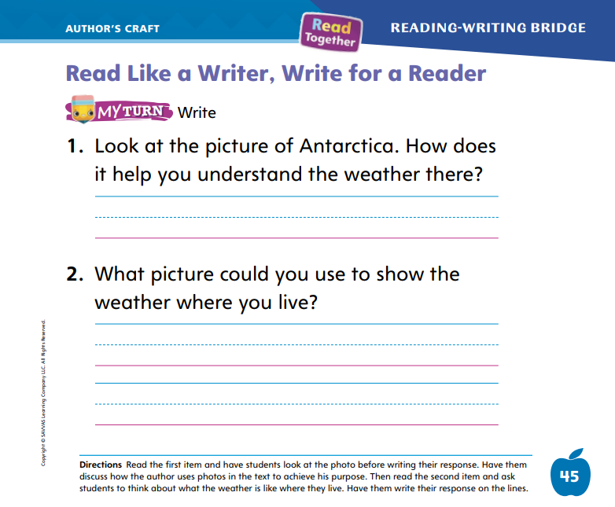
Page 45
Read Like a Writer, Write Like a Reader
Turn to page 45 in your Student Interactive and complete the activity.
Notes:
Explain that authors choose specific photos, pictures, and illustrations to help readers understand texts.
Authors choose photos, pictures, and illustrations carefully.
Interesting photos, pictures, and illustrations can help a reader understand the topic and learn new information.
Have students turn to p. 29 in the Student Interactive. Have students look at the picture on the bottom left. I think the author chose this photo because the deep snow shows that it is a very cold place. The man is by himself carrying a lot of gear. The author wants to show what it might be like to travel in such a cold place. Have volunteers choose another picture from the cover and tell why the author might have chosen it.
Have students turn to p. 45 of the Student Interactive. Read aloud the instructions and questions. Have students complete the activity.

Slide 47
Handwriting
Notes:
Tell students that today they are going to practice writing the numerals 5 and 6. Point to these numerals on the number line and count chorally until you reach the number 5 and then 6.
Model writing the numeral 5. Have students practice writing the numeral 5 in the air with their finger. Repeat with the numeral 6.
Have students use Handwriting p. 269 in the Resource Download Center to practice writing 5 and 6. Click path: Realize -> Table of Contents -> Resource Download Center -> Handwriting Practice -> U5W1L3 Handwriting Practice

Slide 48
Writing – Literary Nonfiction
Where does the author ask a question? How do you know?
Where does the author answer the question?
How do you know it is the answer?
Notes:
Authors write question and answer books to provide information about a topic. Authors might know a lot about the topic, so they are able to answer the questions. If they do not know a lot about the topic, there are other ways to learn information about it. Authors should be careful to make sure their answers directly relate to the question. Authors can:
include details in their answers.
use online resources to learn about a topic.
ask an expert questions to get more information.
Hold up a book from the stack. Say: Question and answer books have two parts: questions and answers. Today we will talk about answers. Open to the first page of the book and ask: Where does the author ask the question? How do you know it is a question? Call on a student to answer.
Then say: Where does the author answer the question? How do you know it is an answer? Allow students to respond. Explain that an answer does not end with a question mark. In a question and answer book, the answer comes after the question. Let’s read this question and answer book. Pay attention to the answers as we read. Read the book aloud so students can notice how an author writes answers.
Read one or two additional books from the stack, pointing out the questions and answers

Slide 49
Independent Writing
Begin writing your question and answer book.
Share a question and an answer from your own book.
Notes:
If students need more time to understand how authors write answers to their questions, have them continue reading stack books.
Writing Support
Modeled - Use stack books to show how answers are written in a question and answer format.
Shared - Have students identify the answers to questions in a stack text.
Guided - Tell students to identify how a question could be answered in a book.
If students show understanding, have them begin or continue writing their own question and answer books.
Have students share a question and an answer from their own book or from a stack book.

Slide 50
Spelling
rat
rot
pat
can
Notes:
Remind students that words with short vowel sounds are often spelled with a consonant-vowel consonant, or CVC, pattern.
Have students write the following words as you say aloud each phoneme: rat, /r/ /a/ /t/; rot, /r/ /o/ /t/; pat, /p/ /a/ /t/; can, /k/ /a/ /n/.
Have students complete Spell Words p. 278 from the Resource Download Center. Click path: Table of Contents -> Resource Download Center -> Spelling -> U5W1L3

Slide 51
Language and Conventions
We are at school.
You and I are at school.
Notes:
Remind students that sentences begin with a capital letter. The word I is always capitalized, even when it is not at the beginning of a sentence.
Display this sentence: We are at school. Read it aloud. Underline the W at the beginning of the sentence. See the W? This is a capital W. This tells me that this is the beginning of the sentence.
Display this sentence with I: You and I are at school. Point out that the word I is capitalized. The word I is always capitalized, even when it is in the middle of a sentence. Underline the word. Then ask: Is the Y at the beginning correct? (Yes, because it is a capital letter, and sentences should begin with capital letters.)

Slide 52
Lesson 4

Slide 53
Page 20, 21
Decodable Story
be
our
saw
Turn to pages 20, 21 in your Student Interactive. We will Read “Tif and Cole.”
Notes:
Have students turn to p. 20 in the Student Interactive. We are going to read a story today about two children who like to play in the snow. Point to the title of the story. The title is Tif and Cole. I hear a word with the sound /ō/. Have students find and point to the word. In this story, we will read many words that have sounds you have learned.
Remind students of this week’s high-frequency words: be, our, saw. Tell them they will practice reading these words in the story Tif and Cole. Display the words. Have students read them with you. When you see these words in the story Tif and Cole, you will know how to identify and read them.
Have students whisper read the story as you listen in. Then have students reread the story with a partner. Listen carefully as they use letter-sound relationships to decode words. Partners should reread the pages. This time the other student begins.
After students have read the pages, review the words with the sound /o/ they read in the sentences on pp. 20–21. Have them underline the words with the sound /o/. Have students read the words to you.
Call students’ attention to the second sentence on p. 20. Which word is a high frequency word we learned this week? Point to it. Help students identify, or say, the word be. Have students look at the sentences on p. 21. Which words include the sound /t/? Point to them. Help students identify, or say, the words Tif, let, to, and spot.

Slide 54
Page 22, 23
Decodable Story
Notes:
Have students turn to p. 22. I see words with the spelling for the sound /ō/. Who can tell me which words have the sound /ō/? Students should identify these words: Cole, smoke, slope.
Have them highlight the words with the sound /ō/ and identify the spelling pattern for long o. Have them continue with p. 23.

Slide 55
Page 29
Make Inferences
Notes:
Tell students that readers put together what they already know, what they read, and what they see in the illustrations to better understand a text. This is called making inferences.
Think about why the author chose this picture or illustration. What is the author trying to tell you?
Use your knowledge and experiences. What do you already know about the people, places, or things in the picture?
Use the picture on p. 35 of the Student Interactive to model making inferences. Point out that you can use the picture, the text, and what you already know to make an inference. I look at the picture on page 35, and I see small buildings that are bolted to the ground with thick wires. Wires can be used to hold tents and small buildings in place. I think it could be really windy in Antarctica. The text tells me that it is windy there. I can make an inference that really cold places can be really windy.
Point out and read aloud the Close Read note on p. 35. Guide students to highlight evidence in the text and pictures that help them make an inference.

Slide 56
Page 35
Close Read – Make Inferences
Turn to page 35 in your Student Interactive.
Notes:
Remind students that readers make inferences using their own knowledge and experiences to understand text or pictures.
Read aloud the Close Read question on p. 35 and have students highlight the words that help them know the answer.
Discuss how they could use their own knowledge and experiences to respond and how the text helped them understand the answer to the question. DOK 2

Slide 57
Page 41
Make Inferences
Turn to page 41 in your Student Interactive and complete the activity.
Notes:
Have students use the strategies for making inferences.
Read aloud the directions on p. 41 of the Student Interactive. Then have students draw an answer to show why people in China wear hats and write evidence from the text that supports their response. Remind students to look back at what they have highlighted.

Slide 58
Page 48
Writing – Literary Nonfiction
Turn to page 48 in your Student Interactive.
Notes:
Ideas for question and answer books come from real-life topics. Authors choose an idea based on something they know a lot about or are interested in. Authors choose a topic and tell readers more about it.
Tell students you would like to write a question and answer book, but you are not sure what to write about. Say: When we write a question and answer book, we have to write the questions and the answers. That means we need to know a lot about the topic. I will brainstorm topics that I know a lot about. I will brainstorm topics that I am interested in.
On the board, write a list of things you know a lot about, such as school, volleyball, dogs, and cooking. When you are finished with your list, think aloud about which topic you know the most about. For example: I’m a teacher, so I’ve spent a lot of time at school. But one of my favorite hobbies is playing volleyball with friends. This is something that I’d love to teach others about, so I will write about volleyball. Circle the topic you have chosen.
Now, let’s brainstorm some ideas for your books. What do you know a lot about? Have students offer suggestions as you write and draw them on the board. Say: We thought of a lot of ideas today. You can come back to this list at any time when you want to begin a new book.
Direct students to p. 48 in the Student Interactive and have them record their favorite ideas.

Slide 59
Independent Writing
Continue writing your question and answer book.
Share your topic with the class.
Explain why you chose that topic.
Notes:
After this lesson, students should transition into independent writing. They should choose a topic and begin their own question and answer books if they have not already.
Writing Support
Modeled - Discuss the question and answer topics in the stack texts.
Shared - Prompt students to generate ideas by looking through the stack texts or class library.
Guided - Have students think about a topic that interests them.
Ask two or three students with whom you conferred to share their question and answer book topics with the class. Encourage students to talk about why they chose that topic and how they will find information to write their answers.

Slide 60
Spelling
bet
vet
red
set
get
den
Notes:
Have students recall the previous spelling rules for spelling words with the CVC pattern and the sound /e/.
Read the following words and have students spell them: bet, vet, red, set, get, den.
Have partners spell two more CVC words with the sound /e/.

Slide 61
Page 46
Language and Conventions
Turn to page 46 in your Student Interactive and complete the activity.
Notes:
Read aloud p. 46 of the Student Interactive. Then have students complete the activity.

Slide 62
Lesson 5

Slide 63
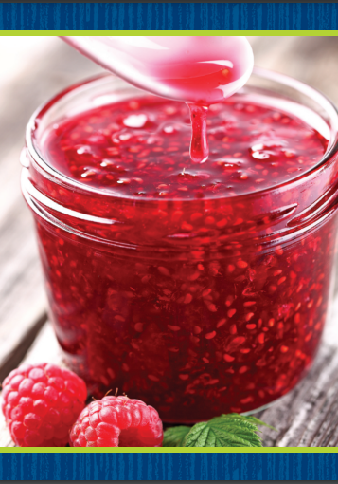
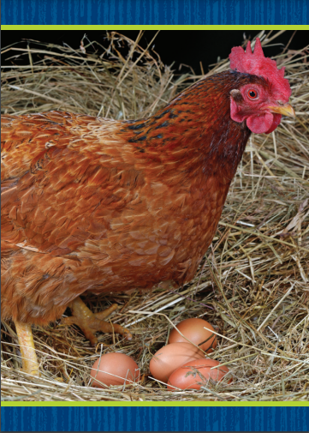
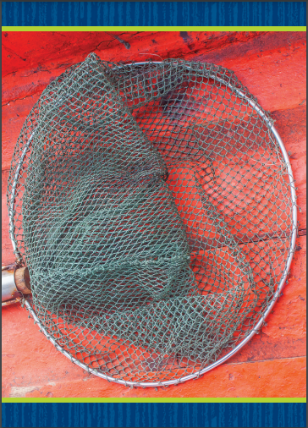
Phonological Awareness
Notes:
Listen to this word as I segment and blend the sounds: tug, /t/ /u/ /g/, tug. How many sounds do you hear in /t/ /u/ /g/? Students should say three. What are they? Students should say the sounds /t/, /u/, /g/. Continue the activity with the words cat, big, hat, and jog.
Provide students with Picture Cards jam, hen, mop, and net. Guide students as they look at each picture and say the word. Then have them slowly segment and blend the phonemes. Click path -> Table of Contents -> Unit 5 Week 1 Informational Text -> Lesson 5

Slide 64
Phonics
Make a web for a bug.
Make a bed for a cat.
Notes:
Tell students that today they will read sentences. The sentences we read will include sound-spellings and high-frequency words we have already learned. You will also draw pictures as you follow directions.
Write the following sentence on the board: Make a web for a bug. Let’s read the sentence together: Make a web for a bug. What does it tell me to do? Yes, it tells me to make a web for a bug. Draw a simple web on the board. What did I draw on the board? Why? (a web because the sentence said to do that.

Slide 65
Page 24
Apply
Turn to page 24 in your Student Interactive and complete the activity.
Notes:
Have students turn to p. 24 in the Student Interactive. Let’s read the first sentence together: Make a bed for a cat. What does the sentence tell you to do? Yes, it tells you to make a bed for cat. Have students draw a bed for a cat in the first box.
Guide students to finish p. 24 in the Student Interactive.

Slide 66
High-Frequency Words
be
saw
our
Notes:
Remind students that high-frequency words are words that appear over and over in texts. Remind them they are learning many of the words this year, and the words will help them become better readers.
Say the word our and ask students what letters spell the word.
Have students
say the letters as you write them on the board.
say and spell the word, doing a silent cheer for each letter.
repeat with be and saw.

Slide 67
Page 42
Reflect and Share
Turn to page 42 in your Student Interactive and complete the drawing.
Notes:
Explain to students that readers can make connections between the ideas in two texts and draw pictures to represent the connections.
Think about what you learned from each of the texts.
Connect what you learned from one text to what you learned from the other text.
Think about a picture you could draw that shows how the texts are connected.
Model how to make a connection between Weather Around the World and another text: I learned about some of the ways people deal with extreme weather. I read another book about houses around the world. Both books told about some of the types of houses people live in because of where they live. I could draw a picture of these houses.
Have students turn to p. 42 of the Student Interactive. Ask students to respond to sources by drawing a type of weather from Weather Around the World and a type of weather from another text.

Slide 68
Page 42
Apply
How have people learned to live in bad weather?
Notes:
Have students talk to a partner to respond to the Weekly Question: How have people learned to live in bad weather?
Encourage students to share examples from the texts they have read and from their own experiences.

Slide 69
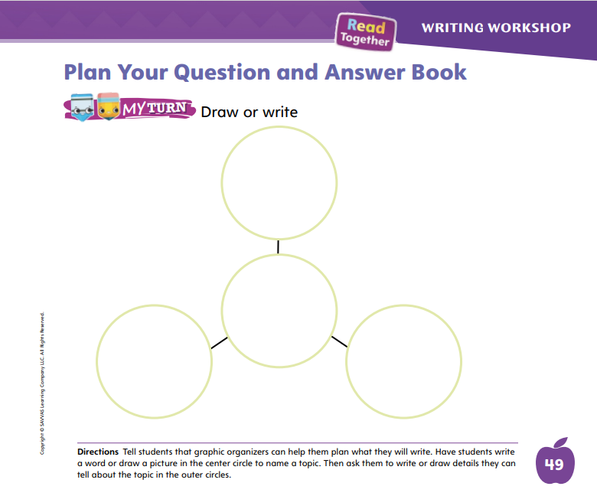
Page 49
Writing – Literary Nonfiction
Turn to page 49 in your Student Interactive.
Notes:
Authors plan question and answer books by thinking about the most important information they know about the topic. Planning a question and answer book helps authors think through the information they will share. Using a graphic organizer ensures that authors include the most important details about the topic.
Tell students that authors may use a graphic organizer to keep track of their topic and questions so they can plan their book. Copy the graphic organizer from p. 49 of the Student Interactive on the board.
Hold up a stack text that you read during the immersion days. Say: Before the author wrote this book, he or she planned what would be included. Let’s pretend we are the authors. Let’s plan our book. We will write or draw the topic in the middle circle of our graphic organizer. Can anyone tell me what the topic of this book is?
Have students say the topic. Write it in the middle circle of the graphic organizer. Then have students name details about the topic as you write them in the surrounding circles. Then say: When you choose your own topic, make sure you choose a topic you know a lot about. Filling out a graphic organizer will help you plan what you know about the topic. If you don’t know enough about your topic, you can choose a different topic, or you can look up information in a book or on a computer.
Give students a few minutes to plan, using their graphic organizer.
Ask a few students to share their graphic organizers with the class. Have them share a question they might write in their book.

Slide 70
Spelling
You can tap your foot to the music.
Pete does not like cheese.
How old will you be next year?
My cat is orange.
Mike put a hat on the dog.
We saw a lion at the zoo.
Notes:
(Note: Move the orange boxes to cover each bold spelling word before you read aloud the words and sentences.)
Read aloud the words and sentences. Have students spell each word with initial consonant blends and the two high-frequency words.
You can tap your foot to the music.
Pete does not like cheese.
How old will you be next year?
My cat is orange.
Mike put a hat on the dog.
We saw a lion at the zoo.
Reveal the spelling word and have students check their work.

Slide 71
Language and Conventions
my family and i like to play cards
What two words should start with a capital letter?
family; I
my; I
like; play
my; cards
Notes:
Display the following sentence and guide students to answer the question. my family and i like to play cards.
What two words should start with a capital letter?
family; I
my; I
like; play
my; cards
Have students complete Language and Conventions, p. 284, from the Resource Download Center. Click path: Table of Contents -> Resource Download Center -> Language and Conventions -> U5 W1

Slide 72
Unit 5: Week 1
Grade K

